Slide 1


Slide 2

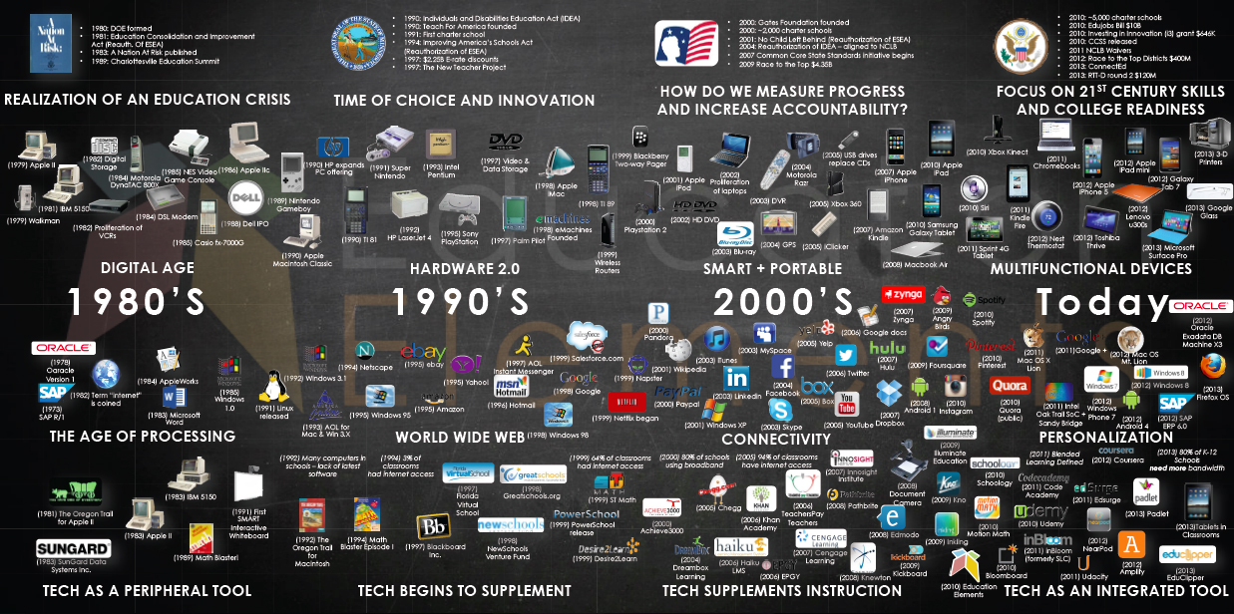
Can Machine Learning Empower Learning ?
A quick review - Edtech
Technology as enabler for the changing learning needs
Main stake holders
The opportunity in Edtech (as we see it)
Market size
Market Readiness
Bringing Big data and Machine Learning to Education

Slide 3
Edtech – It’s all about facilitate learning Learning anything ( or everything), anywhere, anytime by anyone
Anything
From knowledge to skills
New professions
Anyone
K-12
Corporate
Anytime
On demand
Leisure
Anywhere
Higher-Ed
Vocational
Life long learner
New skills
Distance learning
Blended learning
Institutions: schools, university, corporates

Slide 4
The Learning process main stake holders’ needs
Student
Employer
Educator/
learning process
Expected education
-On demand learning
-Personalized, Data Driven
-Ownership of the process
K-12
Unbundle higher education
Vocational
Greater employability
-Targeted education to meet career goals
-Quick micro competencies to improve employability
Corporate learning
Life long learning:
-Inspirational learning
-Avoid being irrelevant and left behind
Bridge employment skill gap
Evolving and Dynamic -4th revolution
Industry needs before academy
New roles
New recruitment procedures and demands
Maximize satisfaction
Deliver better outcome
Teach student what they really want to learn
Nurture specific talents and interest
Bottom-up

Slide 5
The Opportunity in Edtech
Market size
Market Readiness:
Technology:
technology and identified needs
data driven learning
Big Data &ML

Slide 6
Market Size
Education Technology companies sell products and services in more than $1.3T yearly
There are 740M students that are using Edtech product and services
30M world wide are purchasing Edtech products and services

Slide 7
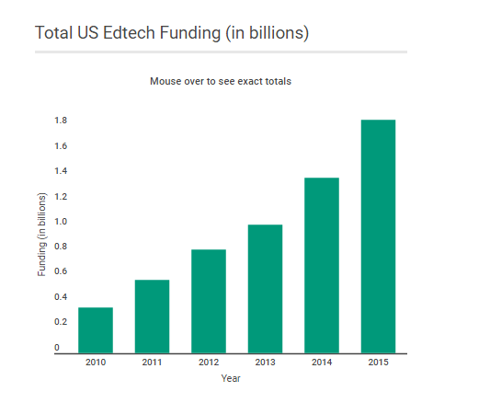
Market Size
Investment peaked in 2015
over 500 deals worth nearly
$3.3B* in aggregate
Edtech goes global, driven mainly by activity in India and China
US from 80% in 2011 to 60% in 2015
* source: CBinsights
** EdSurge counts all investments in technology companies whose primary purpose is to improve outcomes for all learners, regardless of age there fore indicates a number of $2.8B
* source: CBinsights
** EdSurge counts all investments in technology companies whose primary purpose is to
improve outcomes for all learners, regardless of age there fore indicates a number of $2.8B

Slide 8











Market Readiness: Technology and identified needs
Infrastructure
Content, knowledge to skills
Personalization, Data Driven
Diagnostic to Predictive
Focus on HW
Infrastructure & Devices, BYOD
Mobile
Cloud
IoT, VR
OER
Digitized content
Simple UX, easy to navigate
Engagement – games, interactive
MOOCs
“One solution fits all”
Personalized= Pace & performance driven
Personalized = different level of content
Personalized = Discovery
Personalized = Ownership of the learning process
Learning paths
Predictive
More to come

Slide 9
5 phases of Evolution
From Print to Digital
From Knowledge to Skills
From one fits all to Personalized and Data Driven
From Distribution to Discovery
From Diagnostic to Predictive

Slide 10
The Times They Are a-Changin‘…
Data driven learning
Computer-mediated learning
Un-solved pains in education
Machine learning as a service
Regulation changes
Tech Giants involvements

Slide 11
Big Data and Machine Learning - Challenges
Cultural Challenges
Skepticism – does technology will fulfilled the promise ?
Teachers’ new role
Fear of even more test-driven teaching
Tension between didactic/pedagogy theories and practice results driven out of data
Technical Challenges
Need to Redesign content – micro chunks, multi learning paths, open sources
Data – Quality, Ownership, Accessibility, Standardization and Interoperability, Privacy (COPPA)
Training phase

Slide 12
Social interaction > Social skills
Literacy assignments > knowledge implementation
Bio markers > Engagement and Attention
User
machine
Learning Credentials
Summarized/ Accumulate
Survey/ Quiz
Transactional
Open-ended reasoning assignment
Behavioral
Interaction > Engagement
Source of Data
Attendance > drop-out rates
learning efficacy
Size of Corpus

Slide 13

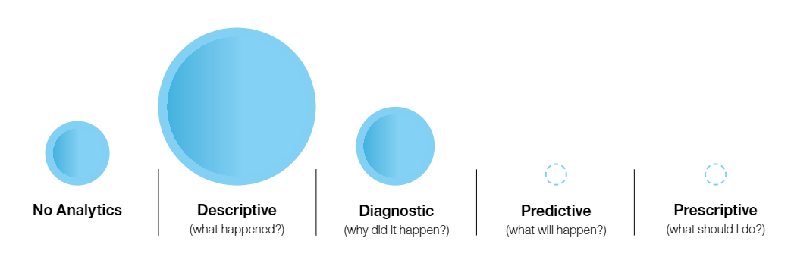
Where are we now? limited analytics capabilities
Which instructional techniques
work for individual ?
How students will perform?

Slide 14



Where are we going? Data- driven cognitive systems
Learner predictive
Better candidate selection
Predict and reduce drop-out rates and students at-risk
Carrier enhancements & career advisers systems
https://vimeo.com/119487844

Slide 15






Where are we going? Data- driven cognitive systems
Personalize learning
Personal learning curve/ learning sequences/ learning path
Automatic feedback (hints, mastery validation, motivation)
Identify skills gaps and improve performances - competency based education
communication, leadership, teamwork, problem-solving, critical thinking
Adaptive engagement
Personality based learning

Slide 16



Where are we going? Data- driven cognitive systems
Content improvement
Automatic Metadata extraction
Engagement
Content adjustments
Content discovery/content recommendation – enabler for move learning out of the classroom

Slide 17
The Opportunity – Is your call for action!
Market size
Market Readiness:
Technology:
Big Data & ML

Slide 18
Thank you !

Slide 19
Sources
http://mfeldstein.com/getting-students-useful-feedback-machine-learning/ http://mfeldstein.com/the-battle-for-personalized-learning/
https://www.edsurge.com/research/special-reports/adaptive-learning
http://tytonpartners.com/library/learning-to-adapt-2-0-the-evolution-of-adaptive-learning-in-higher-education/
https://www.ibm.com/blogs/watson/2016/05/cognitive-systems-will-make-personalized-learning-reality/
https://www.edsurge.com/news/2016-06-08-3-knowns-in-learning-science-and-how-to-apply-them-in-practice
https://www.brookings.edu/wp-content/uploads/2016/06/04-education-technology-west.pdf
https://www.whitehouse.gov/sites/default/files/microsites/ostp/2016_0504_data_discrimination.pdf
http://ero.sagepub.com/content/2/2/2332858416641907
https://codeactsineducation.wordpress.com/2016/06/02/critical-questions-for-big-data-in-education/

Slide 20
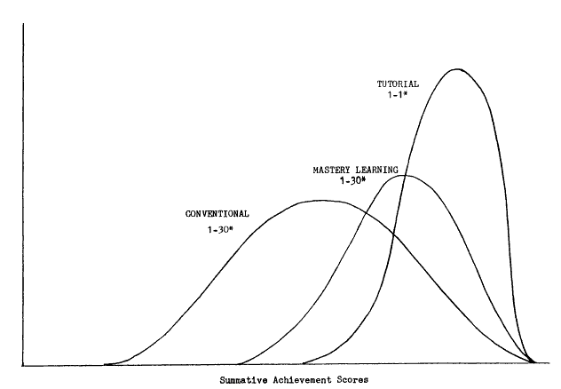
More quotes
Bloom’s Two Sigma finding (Conventional, Mastery Learning, one-on-one tutoring)
Ericsson’s framework of “Deliberate Practice” - elite performer on average takes 10 years or roughly 10,000 hours of sustained practice
Intentional Practice
Challenge Exceeds Skill
Immediate Feedback
Repetition to Automaticity
One of the aims of data science research is to discover empirically the right insights that can make the insights actionable

Slide 21
Benefits
Arises to end the historical separation of instruction and assessment
Quality learning at scale
The learner as a self-educator - Technology Students to Take Charge of Their Own Learning Journeys

Slide 22
Data
Data sources
#GoOpen and OER (open Educational resources)
Digital learning software
MOOCs and others online learning services
ELR (electronic learning records)
In the future – incentives for student records/academic certifications sharing via distributed database
Challenges – Quality, Ownership, Accesses, Standardization and Interoperability
Privacy and COPPA (Children's Online Privacy Protection Rule (under 13 years of age)
access to data, ownership of data, clean data
intensification of didactic pedagogies
test-driven teaching
Evolution of relevant data:
LMS based - attendance, test results, surveys, formative assessment ,,
Online predictive assessments
Interaction with digital content – engagement, learning paste…
Digital exercising – learning efficacy
Social interaction while learning
Micro Credentials
Bio markers - eyes movements, pupil size, brain activity, facial expression
Summarized/ Accumulate data
Transactional data
Survey/ Quiz data
open-ended reasoning (e.g. wirting )
Self generated behavioral data

Slide 23
Where are we going? Data- driven cognitive systems
Learner predictive
Better candidate selection
Predict and reduce drop-out rates and students at-risk
Carrier enhancements & career advisers systems
Personalize learning
Personal learning curve/ learning sequences/ learning path
Automatic feedback (hints, mastery validation, motivation)
Identify skills gaps and improve performances - competency based education
communication, leadership, teamwork, problem-solving, critical thinking
Adaptive engagement
Personality based learning
Content improvement
Automatic Metadata extraction
Engagement
Content adjustments
Content discovery/content recommendation – enabler for move learning out of the classroom

Slide 24
https://vimeo.com/119487844

Slide 25

The Opportunity in Edtech
Market size
Market Readiness: technology and identified needs
Big Data
ML?
Technology-data driven learning

